Slide 1

Book my Spot

Slide 2
Smart Parking System implementation in Metropolitan Cities.
Unavailability of parking spots in metropolitan cities is a challenge which is often undermined.
According to survey by IBM in 2018, finding a parking spot takes 20-25 minutes at an average.
This wastes a lot of time, creates unnecessary stress/frustration and also wastes fuel.
This can also cause traffic in smaller parking lots.

Slide 3
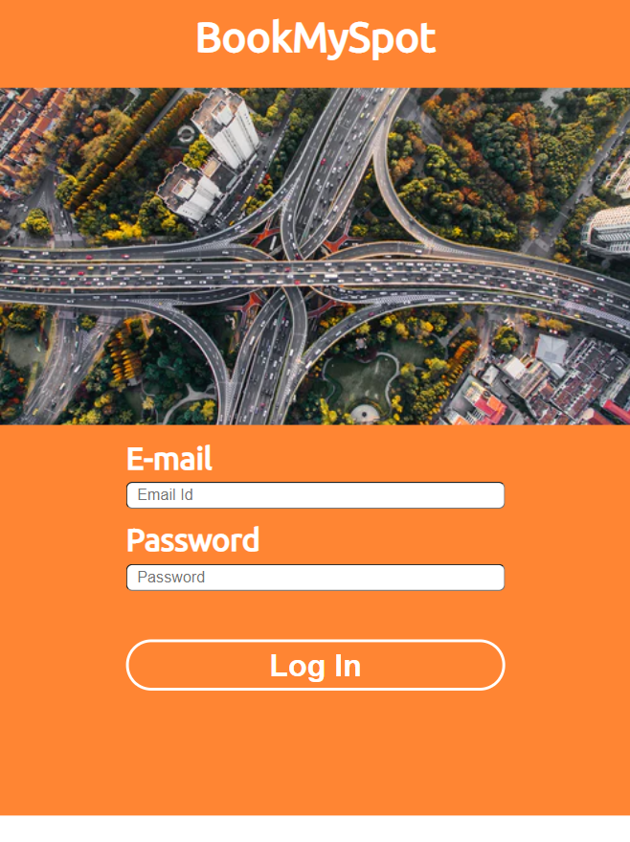
Our solution to this problem is BookMySpot.
A website which allows you to book a parking spot whenever you want, wherever you want.
It is a mobile friendly website.

Slide 4
Practical Scenario
Suppose your favorite film star’s movie is releasing, and you booked your ticket for the first day first show. In mere 5 minutes the hall goes houseful and you consider yourself lucky to have successfully booked a seat for yourself.
On the day of show you leave your house 30 minutes before the start of the movie.
On reaching the theatre you encounter traffic in front of the theatre with just 15 minutes left for the movie to start.
This traffic might have been caused by all those who had come to watch the movie, but since the theatre’s parking capacity could not accommodate all these vehicles, it has now resulted in a traffic.
This single instance can be enough to ruin your day as now you will have to miss the starting of the movie.
All this problem arose as no one had any idea about the parking spot availability of that theater.
BookMySpot can help you to book a parking spot just like you had booked the movie ticket.

Slide 5
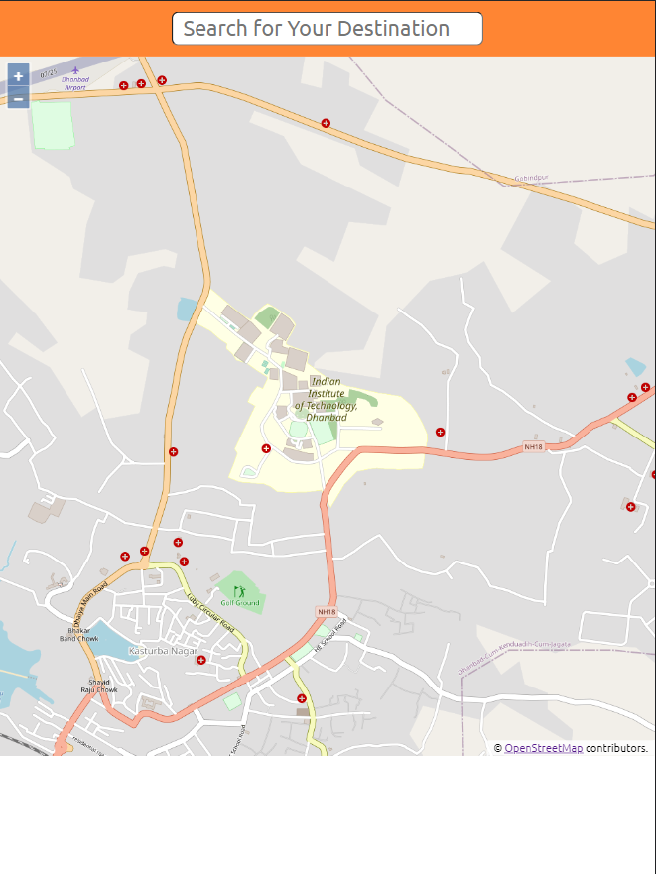
On logging in, a map would be shown with your current location.
Here you can either search your destination or pin your destination on the map

Slide 6
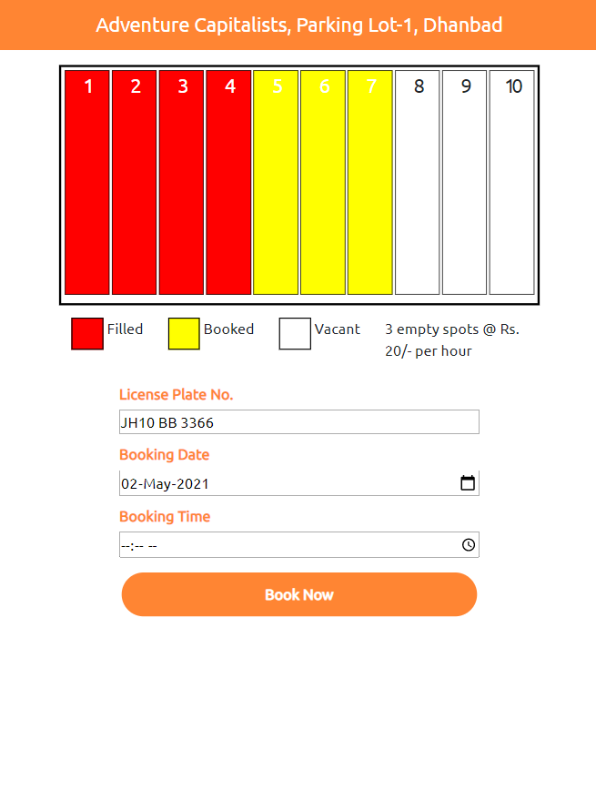
On finding a parking lot there, you can check the status of parking spots currently (ie how many are filled, booked or vacant), or how many spots are pre-booked for a specific future date and time.
All this information of parking spots will be shown in a battery chart, being updated in realtime.
Just enter your Vehicle’s License Plate No., Booking Date, Booking Time and successfully book a parking spot for your vehicle.

Slide 7
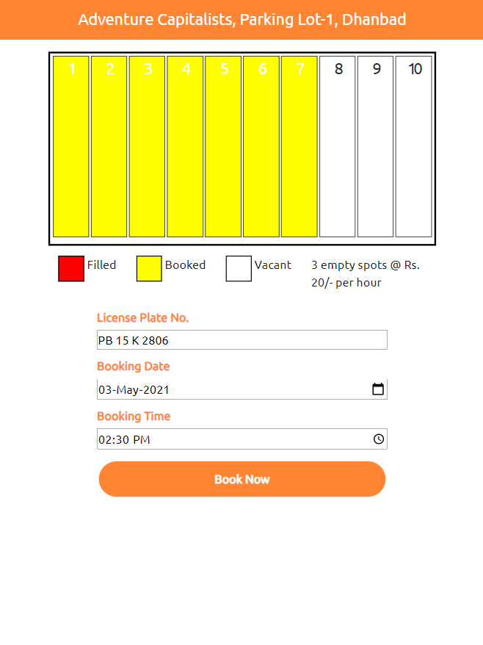
(Example showing status of Parking spots for a future date and time)

Slide 8
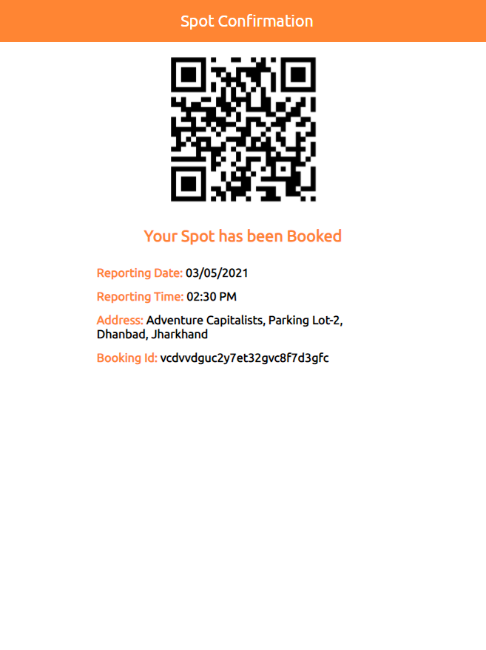
Clicking Book Now books a Parking Spot for your vehicle.
A QR code is generated which will be shown on the screen as well as shared in a link via SMS/Email.
Just scan the QR code on the entrance of the parking lot on the date and time you had booked the spot for.

Slide 9
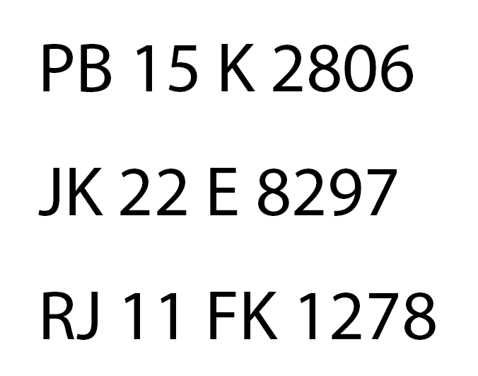
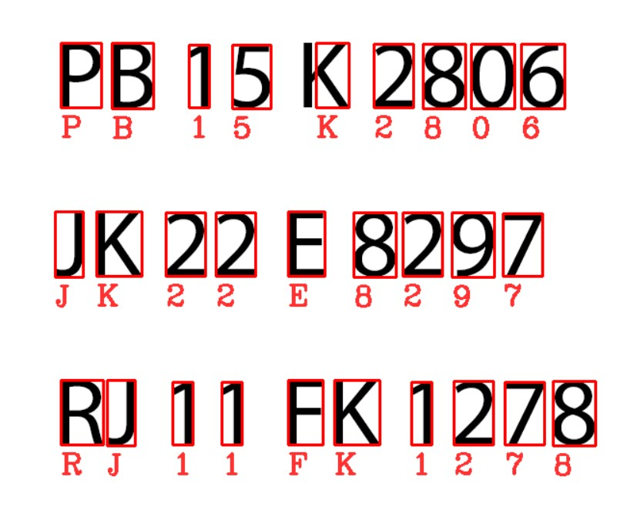
Authentication
After scanning QR code and before entering the parking spot, the license plate of the vehicle will be scanned to check whether the same vehicle is entering the parking lot which has been registered or not.
A camera will click picture of the license plate number and generate a high contrast image of it.
The image will be scanned by our custom OCR (Optical Character Recognition) Program which uses the Tesseract.js library (sample code provided by Benson Ruan @https://github.com/bensonruan/Tesseract-OCR).
The Scanned number will be checked with the registered license plate number to confirm same vehicle is entering the lot.
If there is a mismatch of numbers, the gate won’t open even after scanning the QR code.

Slide 10
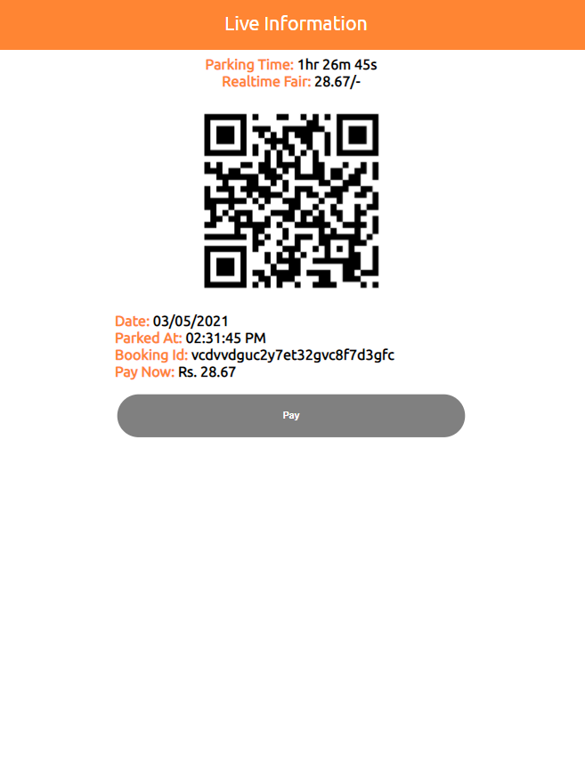
After successfully entering the parking lot, a window with a timer will be shown. Timer showing the total time your car has been parked in the lot for.
The price will be calculated with this timer and shown besides it.
This page will also contain QR code which you will need to scan to leave the parking lot (Ensuring security of vehicles parked in the lot).
The same number scanning mechanism will work while leaving too.
As soon as you scan the QR code to leave the parking lot, Pay option will be enabled which will redirect you to the payment gateway.

Slide 11
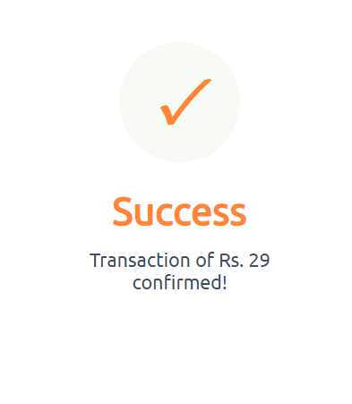

We are also working on faster and easier payment methods like FASTag to make the payment experience even more smooth.

Slide 12
THANK YOU
-BinaryBots
Aryan Gupta - Chitkara University, HP
(aryangupta.cse19@chitkarauniversity.edu.in)
Himanshu Aggarwal - Chitkara University, HP
(himanshuaggarwal.cse19@chitkarauniversity.edu.in)
Rajat Kumar - Chitkara University, HP
(rajatkumar.cse19@chitkarauniversity.edu.in)

